Slide 1


K.RAMAKRISHNAN COLLEGE OF ENGINEERING
(AUTONOMOUS)
BOOK STORE MANAGEMENT SYSTEM
Presented by,
Name : Agalya A
Register No. : 8115U23AD006
Roll. No. : AD2306
Year : II

Slide 2
PRESENTATION OVERVIEW
Objectives
Abstract
Architecture diagram
Module description
Implementation
Conclusion

Slide 3
OBJECTIVES
The objective of the Bookstore Management System is to design and implement a user-friendly, database-driven application that enables efficient management of books within a bookstore.

Slide 4
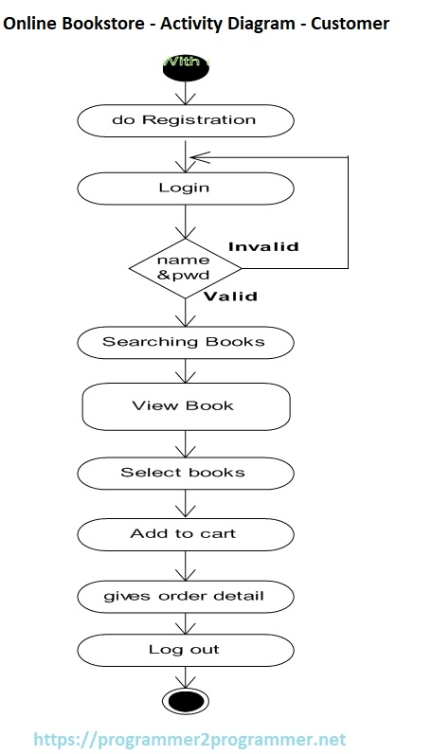
ARCHITECTURE DIAGRAM

Slide 5
MODULES DESCRIPTION
Registration Module: This module allows new users to sign up by entering personal details like name, email, and password. It stores the data securely in the database and ensures users are registered before login.
Login Module: Enables registered users to log into the system. It validates the entered username and password against stored records. If invalid, users are prompted to retry or register.
Search Module: Allows users to search for books using keywords like title, author, or genre. It improves usability by helping customers find specific books quickly.
View Book Module: After searching, users can view detailed information about each book such as description, author, price, and availability.

Slide 6
MODULES DESCRIPTION
Book Selection Module: Enables users to select one or more books they wish to buy. This interaction typically adds books to a temporary selection or wishlist.
Cart Module: This module manages the cart functionality where selected books are added for purchase. Users can update quantity or remove items before placing the order.
Order Details Module: Displays a final summary of the order including book names, quantity, prices, and total cost. Users confirm the order from this screen before checkout.
Logout Module: Ends the current session securely. It ensures customer data is protected and prevents unauthorized access after the user leaves.

Slide 7
CONCLUSION
A Bookstore Management System enhances efficiency by streamlining inventory, customer orders, and sales transactions. It ensures organized data storage, fast order processing, and effective stock management. By using a relational database, bookstores can improve customer service, reduce manual errors, and boost overall productivity.

Slide 8


